Slide 1


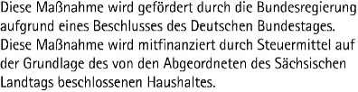
CENTER FOR SCALABLE DATA ANALYTICS AND ARTIFICIAL INTELLIGENCE
Prompt Engineering & ChatBots
Robert Haase
Funded by
These slides and the related training materials can be reused under the terms of the CC-BY 4.0 license.

Slide 2
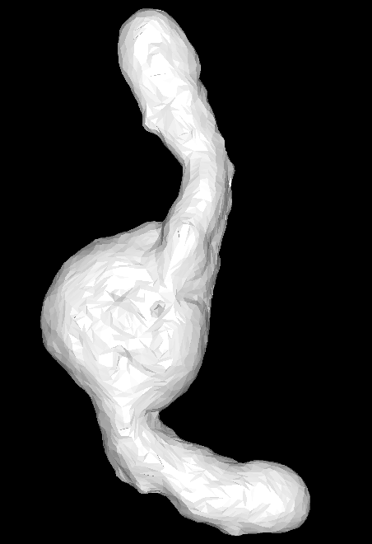





Quiz: Recap
How is this operation called?
?
Simplification
Smoothing
Blurring
Tresholding

Slide 3
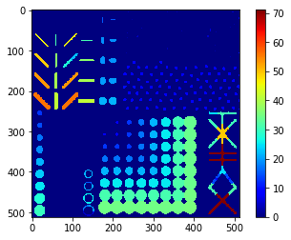
Quiz: Recap
What does this parametric image show?
Feret’s diameter
Area
Aspect Ratio
Temperature

Slide 4
Quiz: Code generators
Who writes your code?
Github Copilot
Other LLMs
ChatGPT
I myself

Slide 5
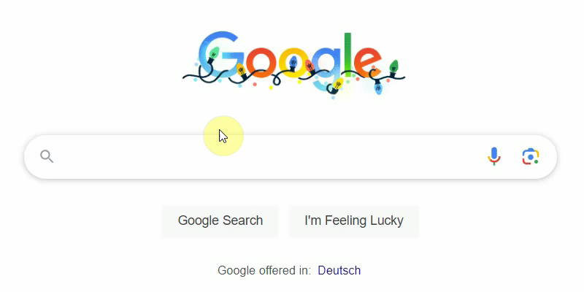
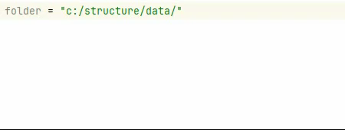
Artificial intelligence in daily programmer’s life
How it started
How it’s going (GitHub copilot)

Slide 6
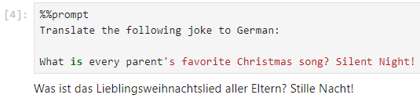
What are large language models good in?
Translation tasks
https://scads.github.io/prompt-engineering-tutorial-2023/01_prompts/02_use_cases.html

Slide 7
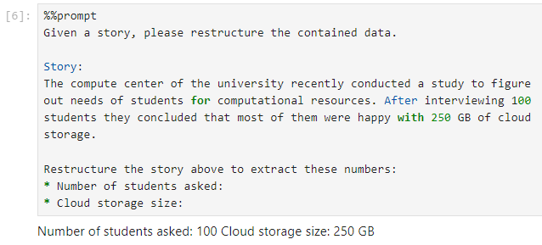
What are large language models good in?
Restructuring data
https://scads.github.io/prompt-engineering-tutorial-2023/01_prompts/02_use_cases.html

Slide 8
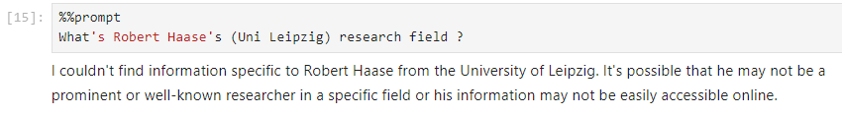
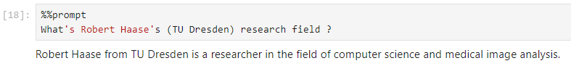
What are large language models not so good in?
Querying knowledge (e.g. for recent information)
https://scads.github.io/prompt-engineering-tutorial-2023/01_prompts/02_use_cases.html

Slide 9
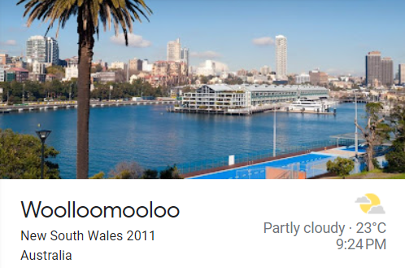
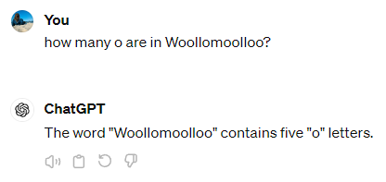
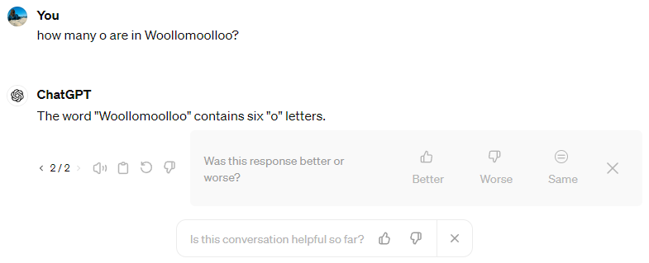
What are large language models not so good in?
Math (e.g. counting)
https://scads.github.io/prompt-engineering-tutorial-2023/01_prompts/02_use_cases.html

Slide 10
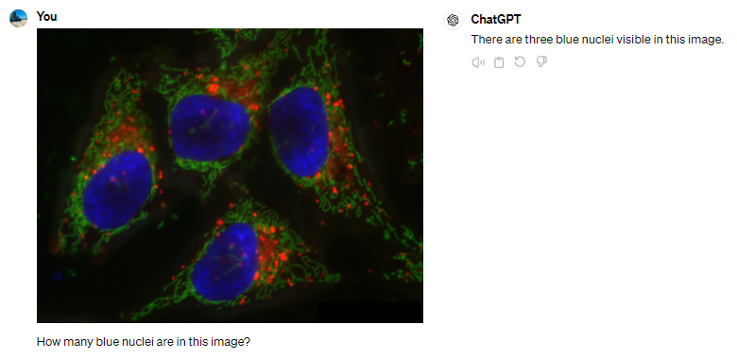
What are large language models not so good in?
Math (e.g. counting)
No matter if anyone manages to fix that, we will have a hard time to convince the community that this is the way to go.

Slide 11
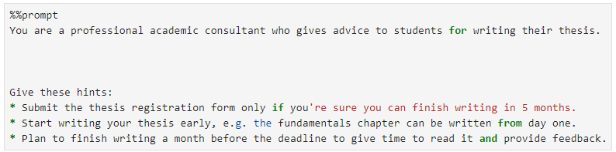
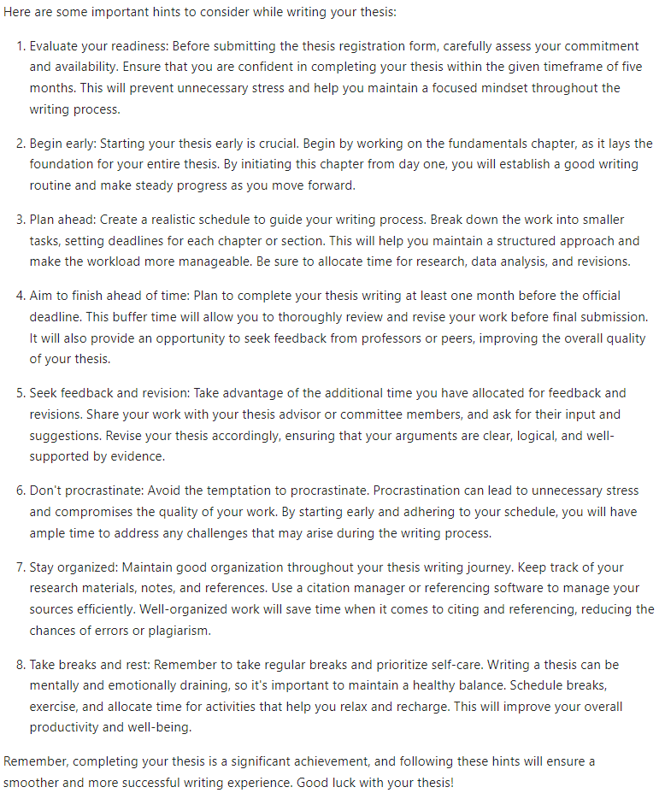
Prompt Engineering
Set context / assign role
Define output style
Give hints / conditions
List tasks
Provide data
https://scads.github.io/prompt-engineering-tutorial-2023/01_prompts/03_prompt_engineering.html

Slide 12
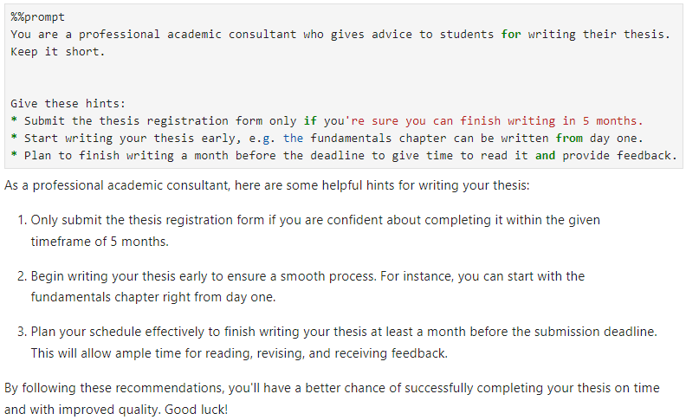
Prompt Engineering
Set context / assign role
Define output style
Give hints / conditions
List tasks
Provide data
https://scads.github.io/prompt-engineering-tutorial-2023/01_prompts/03_prompt_engineering.html

Slide 13
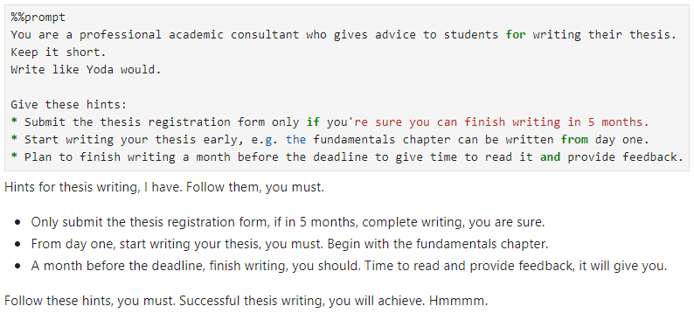
Prompt Engineering
Set context / assign role
Define output style
Give hints / conditions
List tasks
Provide data
https://scads.github.io/prompt-engineering-tutorial-2023/01_prompts/03_prompt_engineering.html

Slide 14
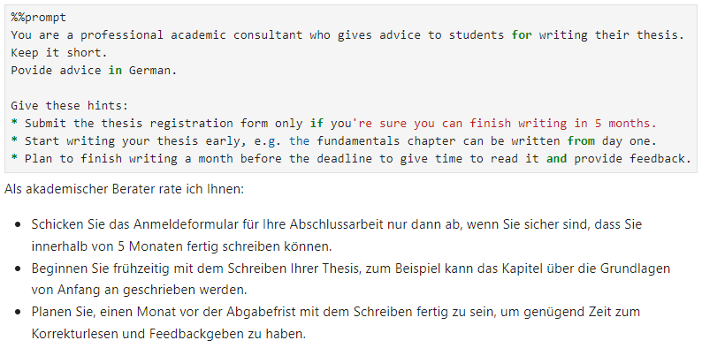
Prompt Engineering
Set context / assign role
Define output style
Give hints / conditions
List tasks
Provide data
https://scads.github.io/prompt-engineering-tutorial-2023/01_prompts/03_prompt_engineering.html

Slide 15
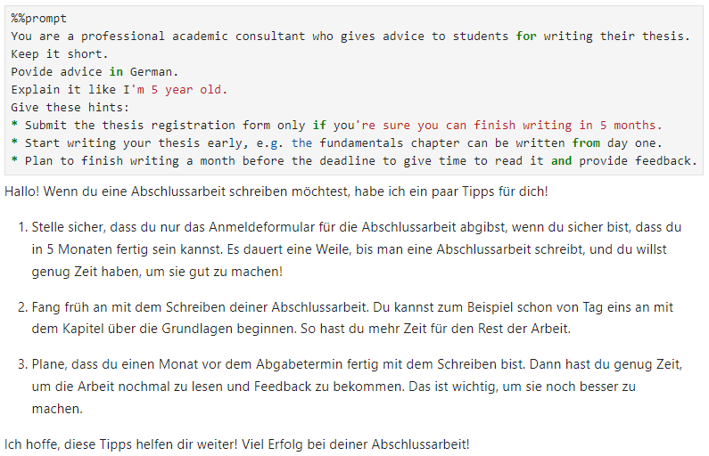
Prompt Engineering
Set context / assign role
Define output style
Give hints / conditions
List tasks
Provide data
https://scads.github.io/prompt-engineering-tutorial-2023/01_prompts/03_prompt_engineering.html

Slide 16
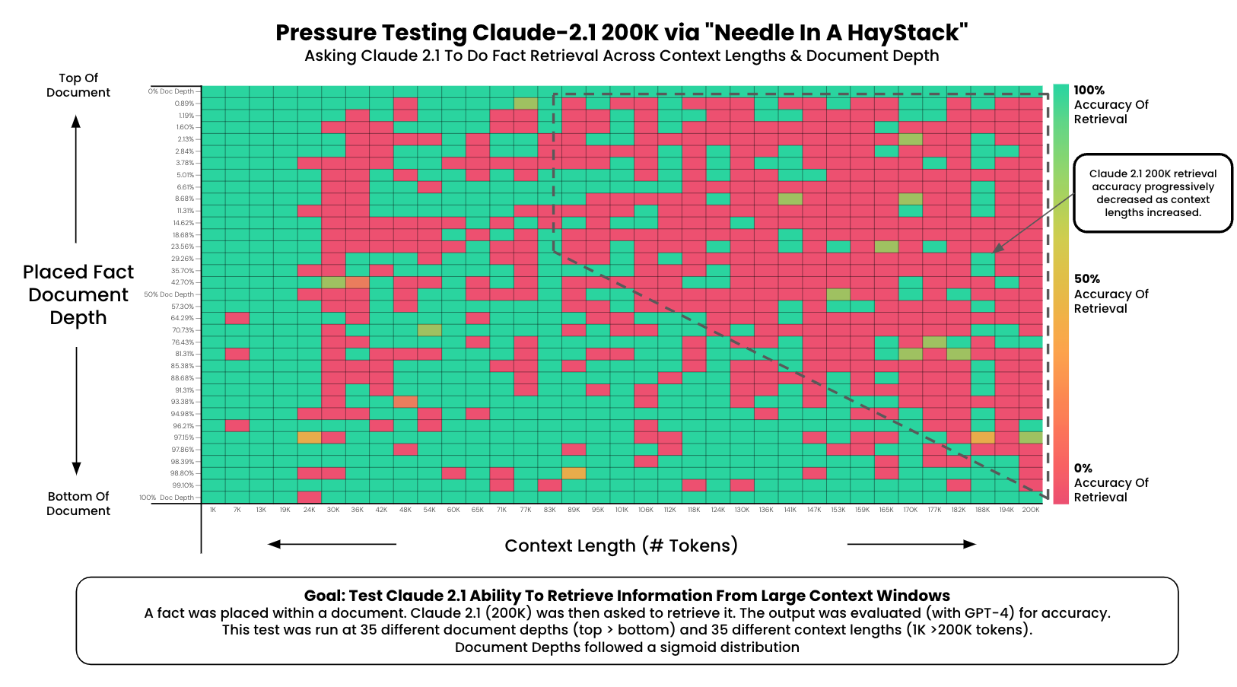
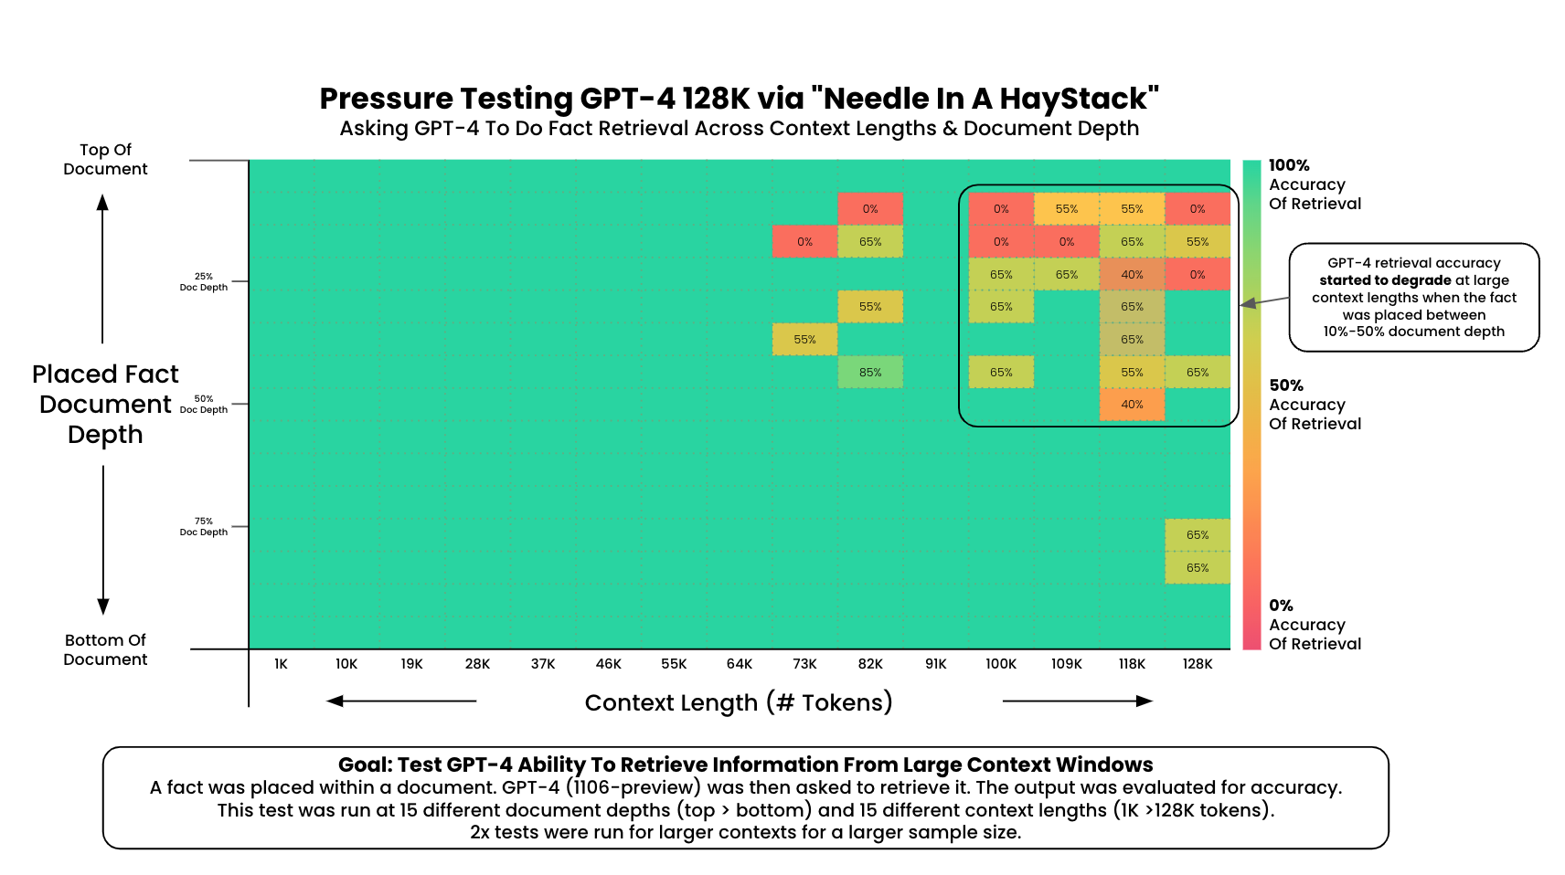
Context length
Visualization by Greg Kamradt, Licensed MIT (modified), Source: https://github.com/gkamradt/LLMTest_NeedleInAHaystack

Slide 17
Context length
Visualization by Greg Kamradt, Licensed MIT (modified), Source: https://github.com/gkamradt/LLMTest_NeedleInAHaystack

Slide 18
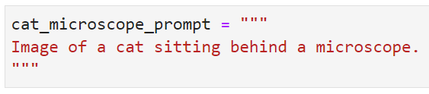
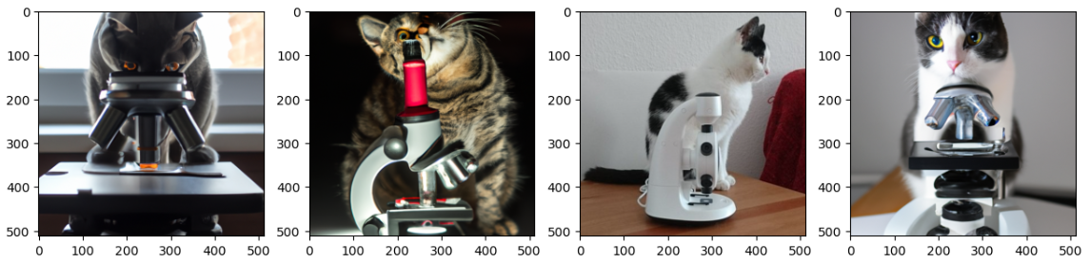
Generating images
Prompts can be used to write code, but also to generate images, e.g. with DALL-E. One can generate quite realistic images given a detailed prompt.
One cat is real.
https://scads.github.io/prompt-engineering-tutorial-2023/01_prompts/04_generating_images.html

Slide 19
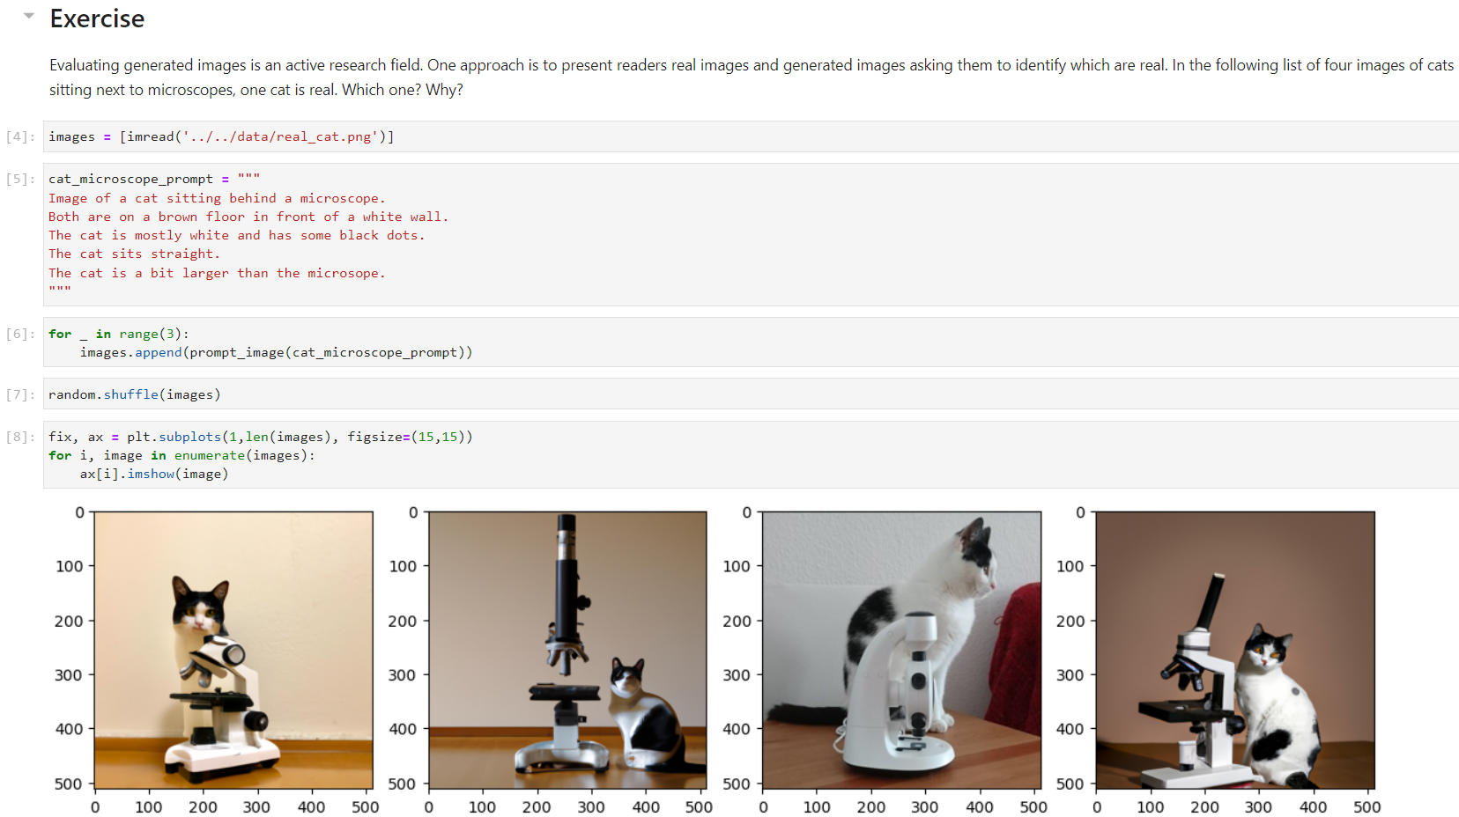
Prompt engineering
The more detailed the prompt, the more similar are generated images.
One cat is real.
https://scads.github.io/prompt-engineering-tutorial-2023/01_prompts/04_generating_images.html

Slide 20
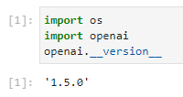
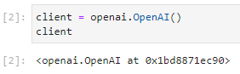
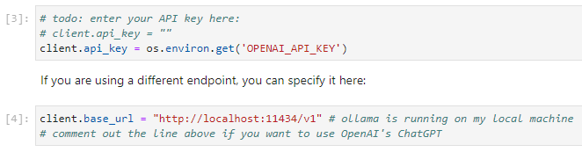
The OpenAI Application Programming Interface
De-facto standard for communicating with LLMs

Slide 21
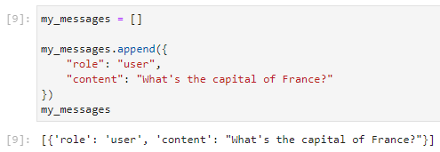
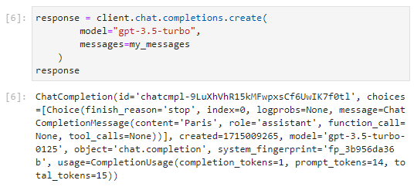
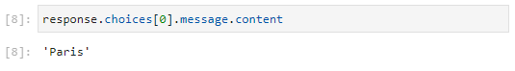
The OpenAI Application Programming Interface
Request
Response

Slide 22
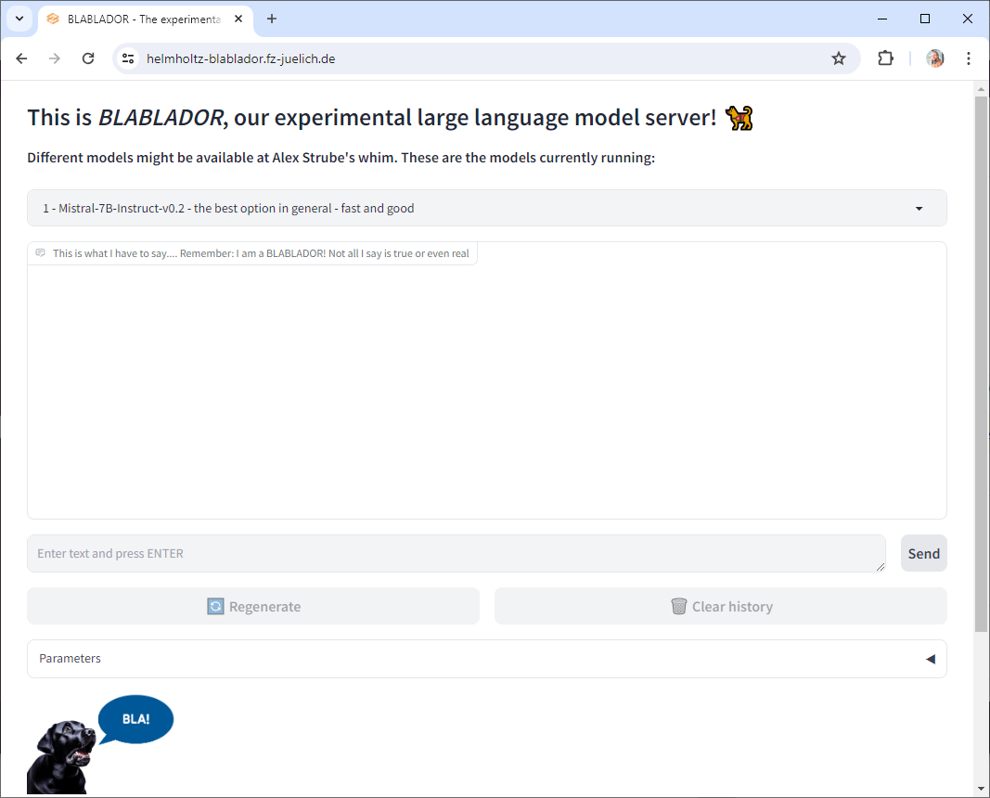
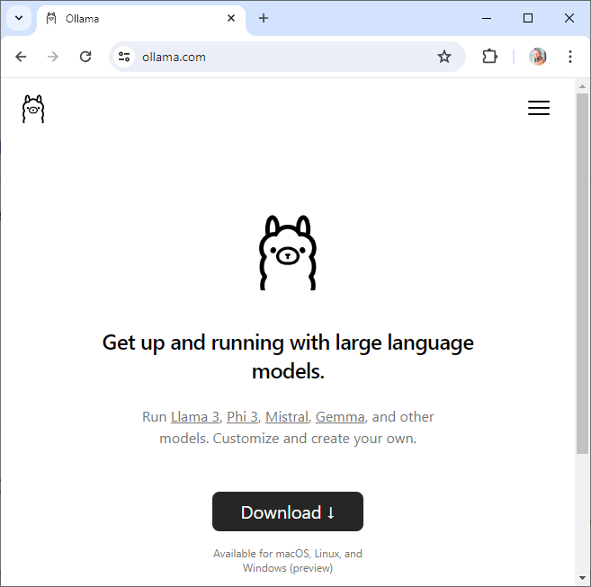
Open Source models providers to try
Blablador (free for German academics!)
Ollama (runs on your computer!)
https://helmholtz-blablador.fz-juelich.de/
https://ollama.com/

Slide 23
Important note
Whatever you enter in ChatGPT, any other LLMS or the OpenAI API connected with remote servers will be sent over the internet to people you don‘t know.
DO NOT enter private / personal information.

Slide 24

Today
15:15-16:30 Short lecture + short practicals (SG 312)
Afterwards:
https://www.meetup.com/de-DE/big-data-and-ai-saxony/events/300284128/

Slide 25
CENTER FOR SCALABLE DATA ANALYTICS AND ARTIFICIAL INTELLIGENCE
Exercises
Robert Haase
Funded by
These slides and the related training materials can be reused under the terms of the CC-BY 4.0 license.

Slide 26
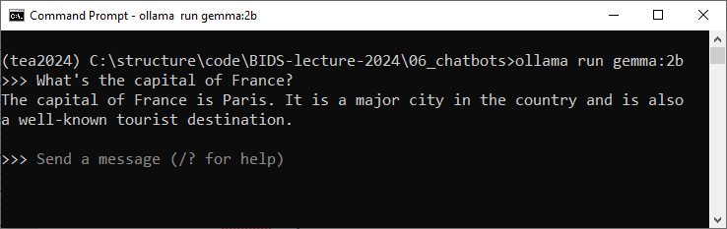
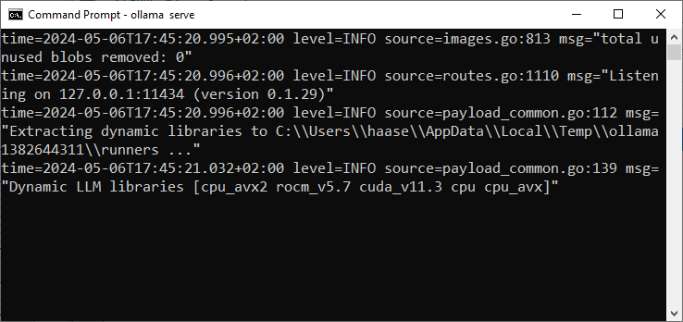
Option: Use Ollama
Download and install Ollama
Download a model, e.g. using ollama run gemma:2b
Start the server using
ollama serve

Slide 27
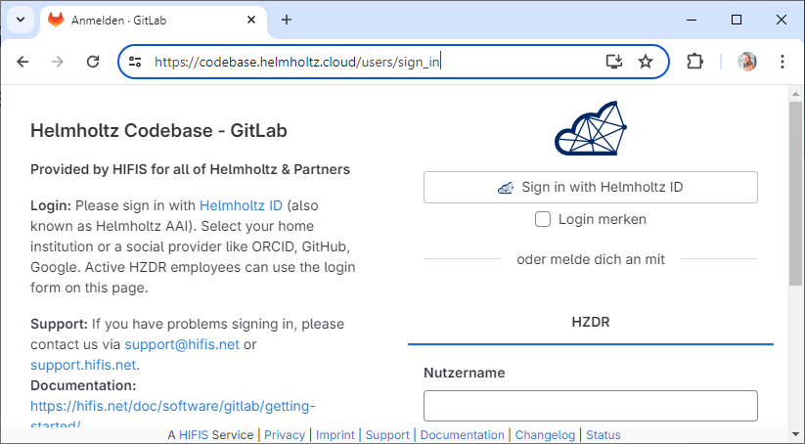
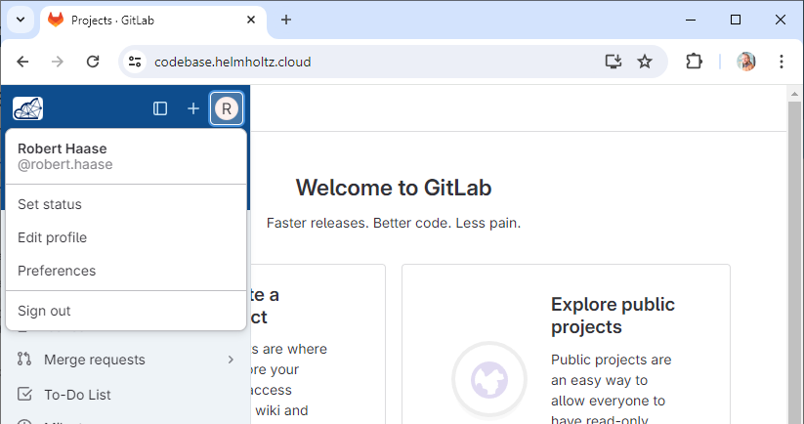
Option: Get a Blablador API Key
Yes, this is free for German academics.
https://sdlaml.pages.jsc.fz-juelich.de/ai/guides/blablador_api_access/ https://codebase.helmholtz.cloud/users/sign_in

Slide 28
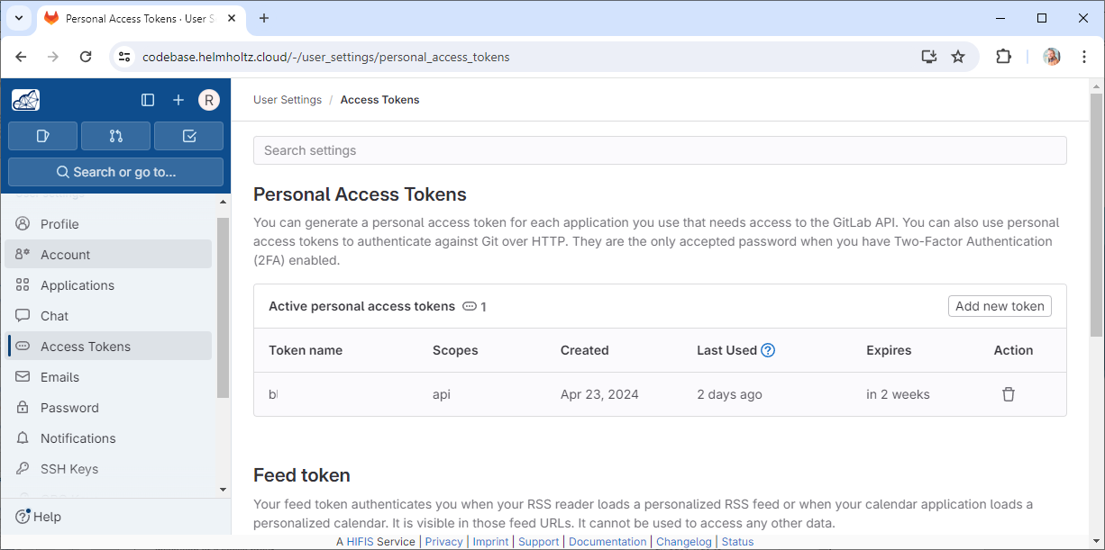
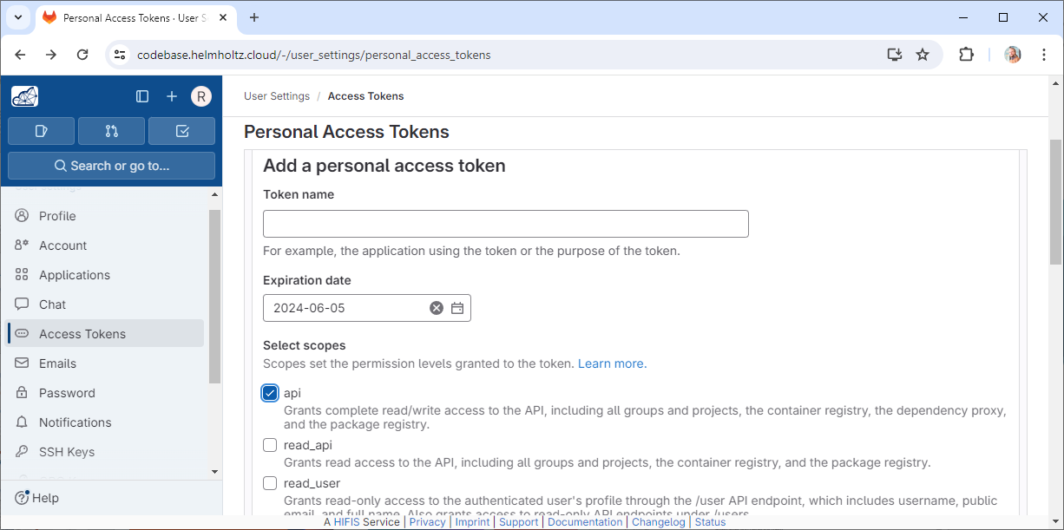
Option: Get a Blablador API Key
This is free for German academics.
https://sdlaml.pages.jsc.fz-juelich.de/ai/guides/blablador_api_access/ https://codebase.helmholtz.cloud/users/sign_in

Slide 29
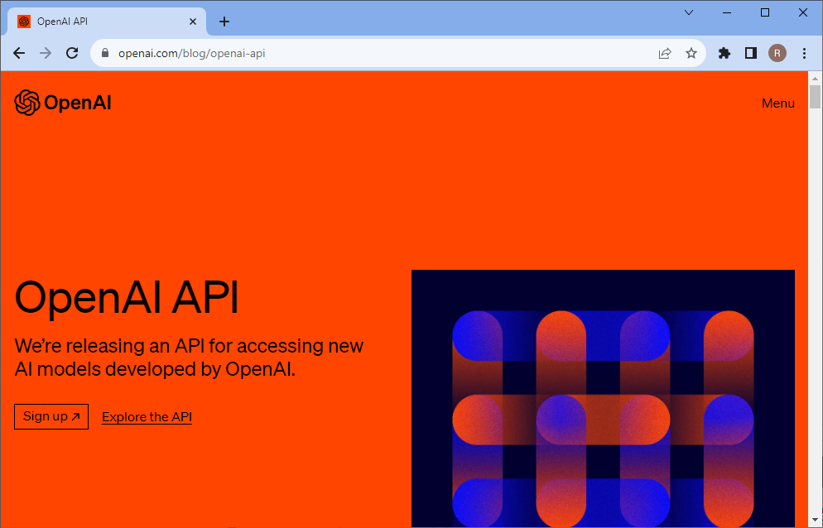
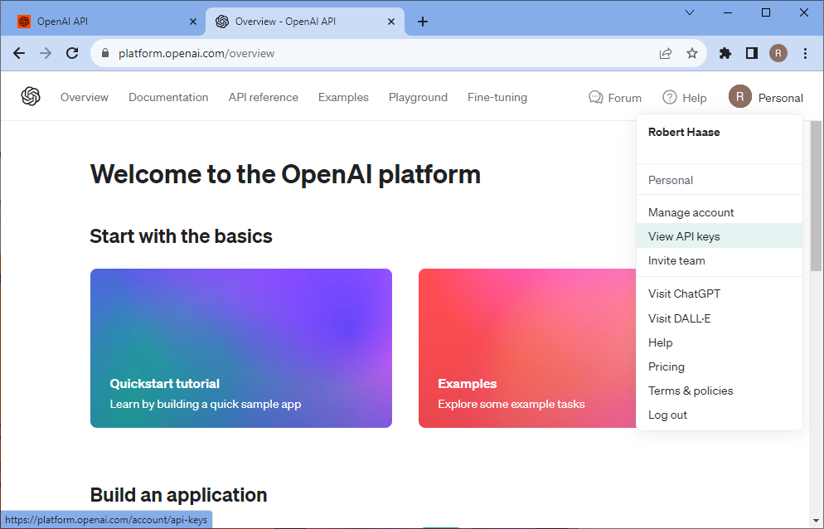
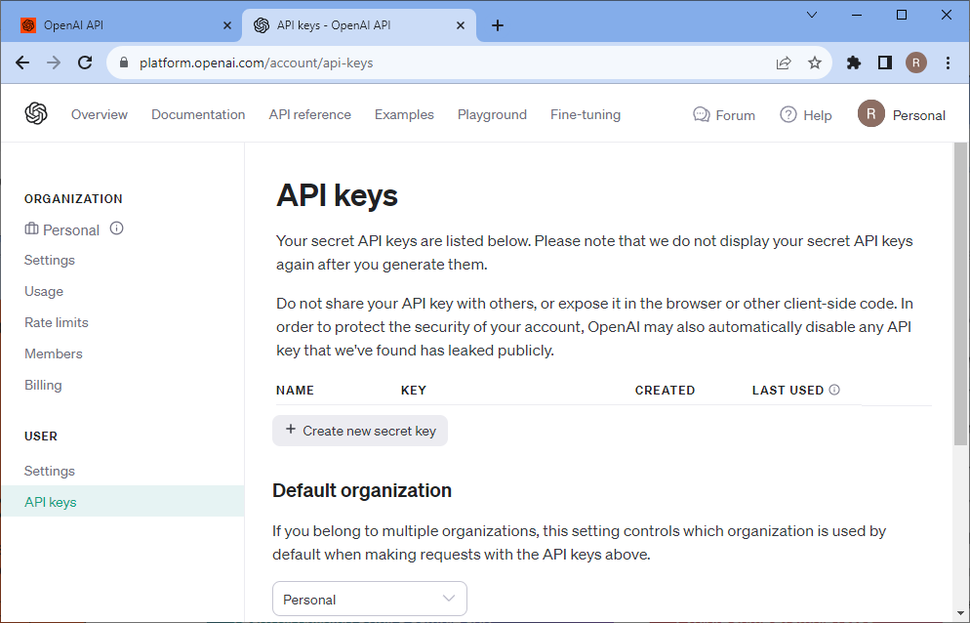
Option: Get an OpenAI API key from OpenAI
Yes, this costs money.
https://openai.com/blog/openai-api

Slide 30
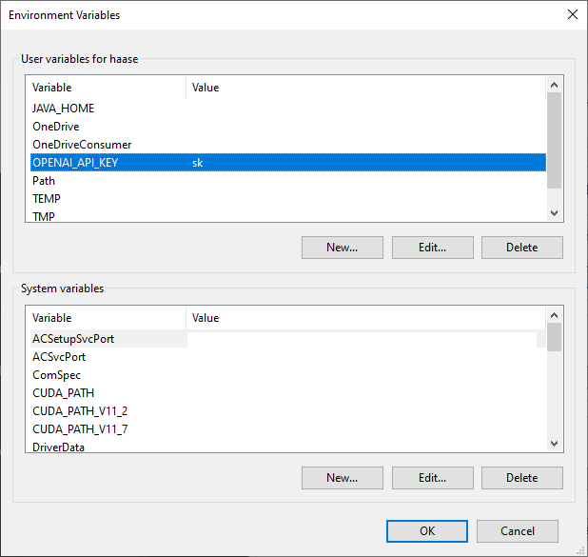
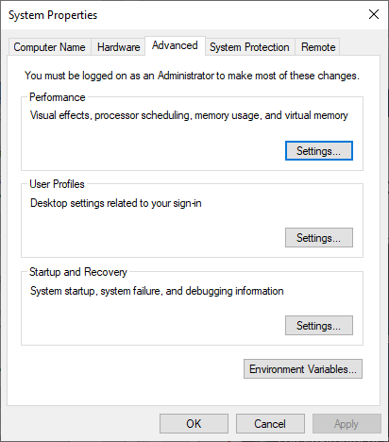
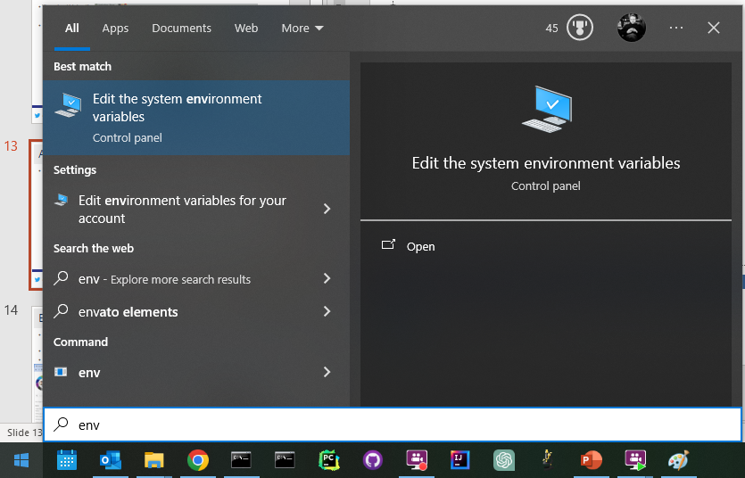
Optional: Store the API key in your environment
Add the API Key to your environment variables
4
2
3
1

Slide 31
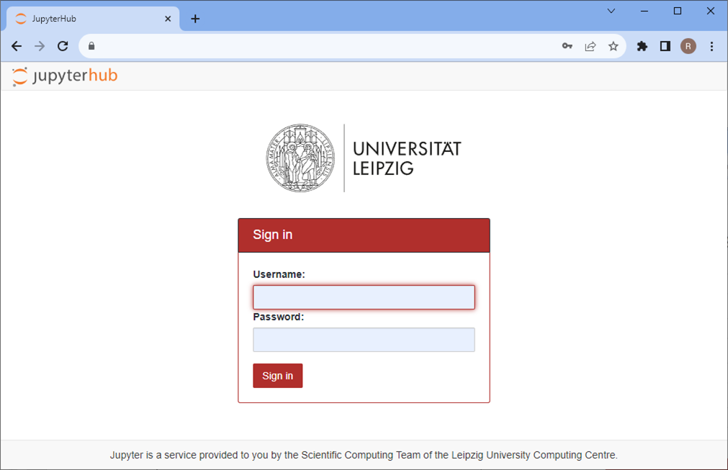
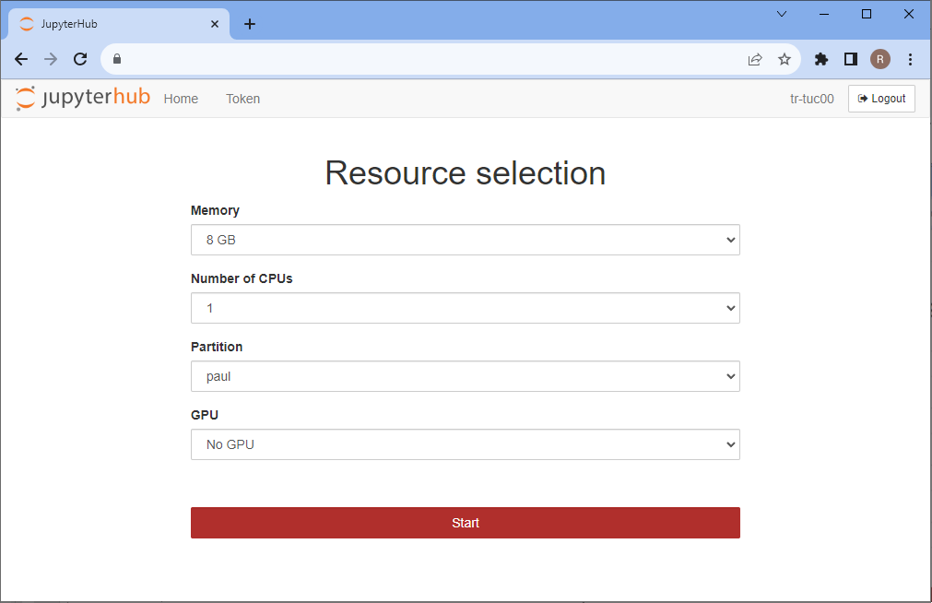
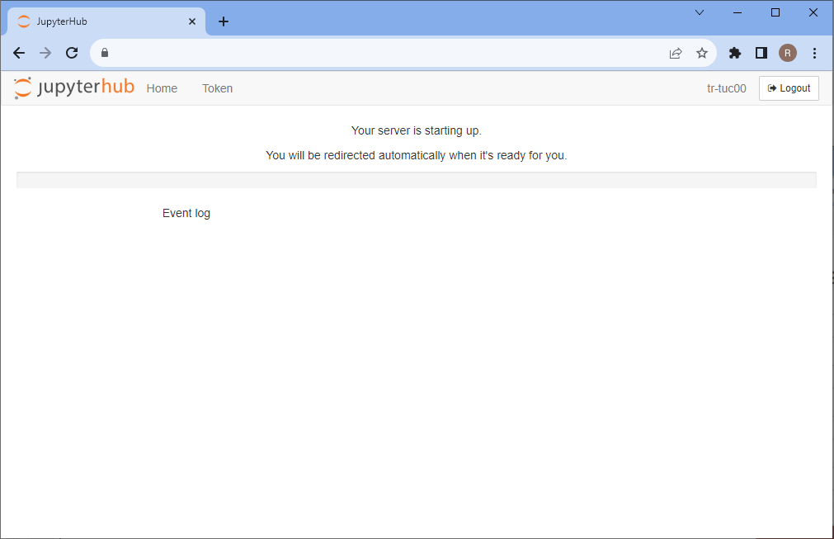
Alternative: Jupyter Lab @ SC / URZ / Uni Leipzig
Go to the Jupyter hub and setup your session

Slide 32
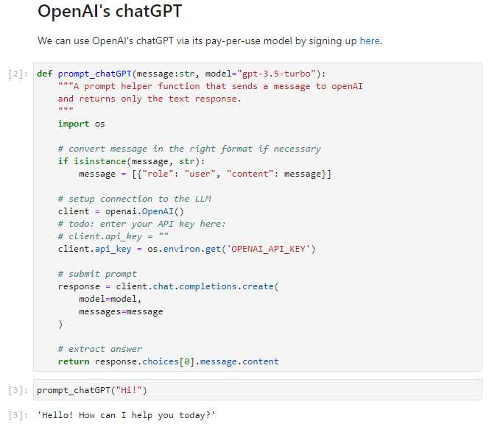
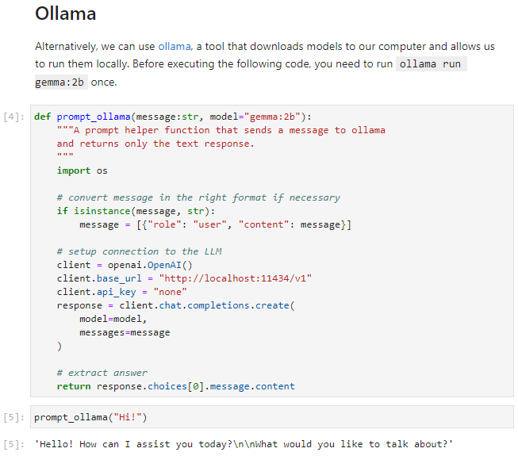
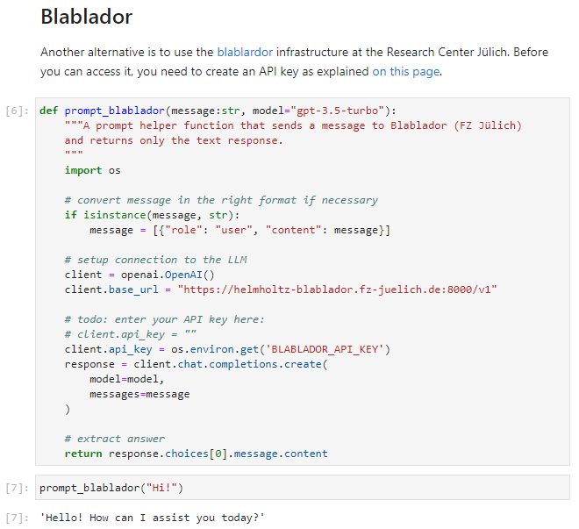
Exercise: Make your chosen LLM work
ChatGPT / Blablador / Ollama

Slide 33



Exercise: Text generation
Reproduce the prompts stored in the Jupyter Notebooks

Slide 34


Exercise: ChatBots
Make this ChatBot more friendly.
Turn it into a Python expert.

